Slide 1
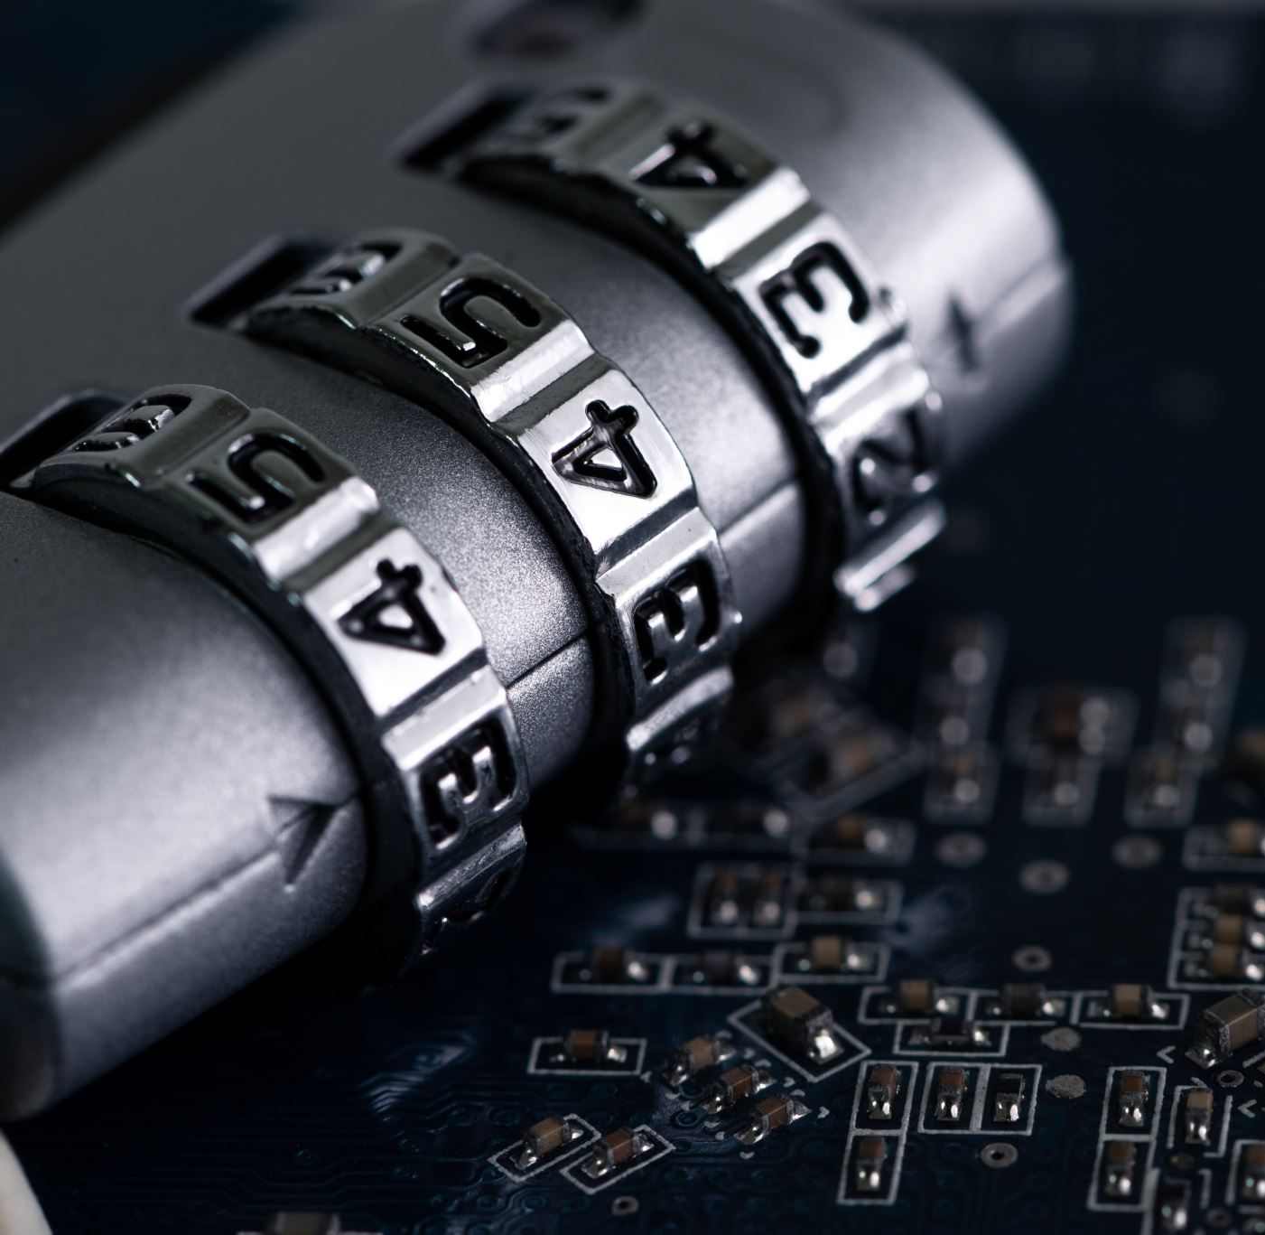
Entity Authentication
Cryptography
Notes:
This chapter begins with a discussion of the wide variety of applications for
cryptographic hash functions. Next, we look at the security requirements for such
functions. Then we look at the use of cipher block chaining to implement a cryptographic
hash function. The remainder of the chapter is devoted to the most important
and widely used family of cryptographic hash functions, the Secure Hash Algorithm
(SHA) family.

Slide 2
Entity Authentication
Entity authentication is a technique designed to let one party prove the identity of another party.
An entity can be a person, a process, a client, or a server.
The entity whose identity needs to be proved is called the claimant;
The party that tries to prove the identity of the claimant is called the verifier.
There are two differences between message and entity authentication
Message authentication might not happen in real time; entity authentication does
Message authentication simply authenticates one message; the process needs to be repeated for each new message but
Entity authentication authenticates the claimant for the entire duration of a session

Slide 3
Verification Categories
Something Known
A secret known only by the claimant that can be checked by verifier
Passwords, PIN, secret key, private key
Something Possessed
Something that can prove the claimant’s identity
Passport, driver’s license, ID card, credit card, smart card
Something Inherent
Inherent characteristic of the claimant
Conventional signatures, fingerprints, facial charactersitcs, handwriting.

Slide 4
Passwords
The simplest and oldest method of entity authentication is the password-based authentication, where the password is something that the claimant knows.
We can divide these authentication schemes into two groups
Fixed password
One-time password

Slide 5
Fixed Passwords
A fixed password is a password that is used over and over again for every access
Several Schemes have been built
First Approach
The system keeps a table (a file) that is sorted by user identification.
To access the system resources, the user sends her user identification and password, in plaintext, to the system
The system uses the identification to find the password in the table
If password matches the table entry, access is granted; otherwise denied

Slide 6
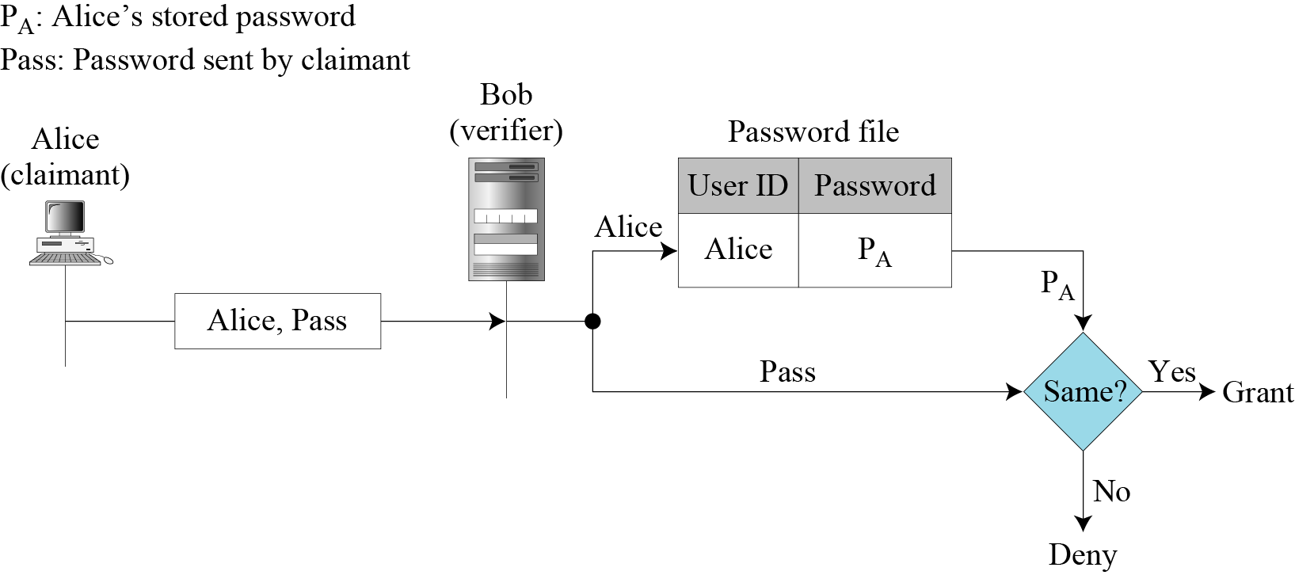
Fixed Passwords
First Approach
aa

Slide 7
Fixed Passwords (Attacks on first approach)
Eavesdropping:
Eve can watch Alice when she types her passord (***** used to protect)
Eve can listen to the line and intercept the message
Stealing Password:
If password written somewhere, it can be stolen (memorize to protect)
Memorization results in selection of BREAKABLE password.

Slide 8
Fixed Passwords (Attacks on first approach)
Accessing Password File:
Eve can hack into the system and get access to ID/Password file
We will see how second approach protects file from such attacks
Guessing:
If passwords are short, Password breakers can be used
Human behavior, related data like birthday, phone numbers etc.
Longer and random alphanumeric added with symbol passwords are better.
Results in complicated password so need to write.
Now password can be stolen ☹

Slide 9
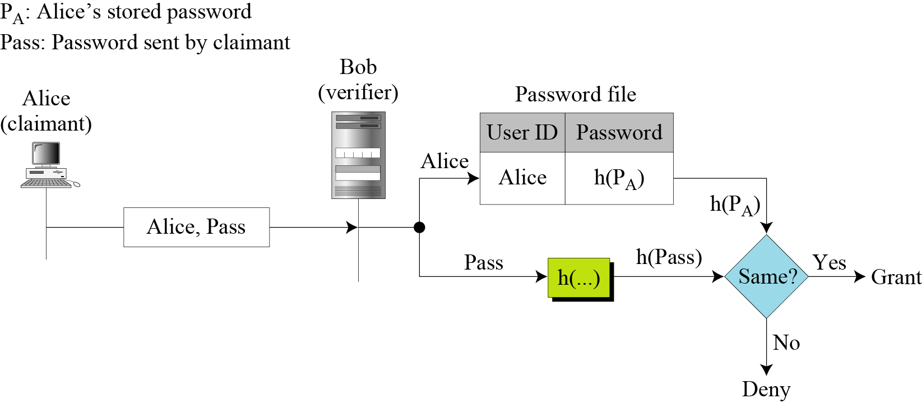
Fixed Passwords
Second Approach
Store the hash of the password
Any user can read contents of file but as the hash function is a one-way function, impossible to guess the value of password.
When password is created, the system hashes it and stores it
When Id/password is provided, password is matched to hashed value

Slide 10
Fixed Passwords
Dictionary attack on Second Approach
If a password is like of 5 characters, Eve creates list of all possible values and then applies hash function to every number
Gets the password file and check all combinations, offline
After match is found, Eve goes online and uses the password to access the system
The third approach shows how to make this attack more difficult

Slide 11
Fixed Passwords
Third Approach
Salting the password
When the password string is created, a random string, called the salt, is concatenated to the password
The salted password is then hashed
ID, Salt and the hash are stored in the file
When a user asks for access, the system extracts the salt, concatenates it with the received password. Makes a hash out of the result, and compares it with the hash stored in the file
If there is a match, access is granted; otherwise denied

Slide 12
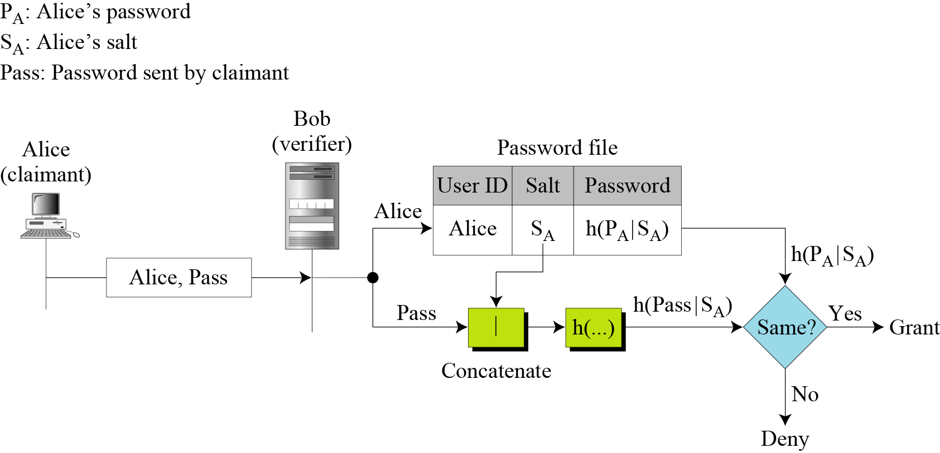
Fixed Passwords
Third Approach
If original message is 5 digit and salt is also 5 digit. Now we have a 10 digit value
Eve’s list is huge now. We can make salt even a bigger number.
UNIX OS, uses a variation of this method

Slide 13
Fixed Passwords
Fourth Approach
Two identification techniques are combined(multi-factor authentication).
A good example of this type of authentication is the use of an ATM card with a PIN (personal identification number).
Card belongs to “something possessed”, PIN belongs to “something known”

Slide 14
One Time Passwords
A password that is used only once
Eves dropping is useless now
First Approach
In the first approach, the user and the system agree upon a list of passwords.
Each password in list can only be used once
Problems:
System and user must use a long list of passwords
If user does not use passwords in sequence the system needs to perform a long search to find the match

Slide 15
One Time Passwords
Second Approach
In the second approach, the user and the system agree to sequentially update the password.
User and system agree on first password P₁, valid only for first access.
During first access user generates password P₂ and encrypts it with P₁ as the key and so on
Problem:
If Eve can guess the first password, she can guess all next

Slide 16
One Time Passwords
Third Approach
In the third approach, the user and the system create a sequentially updated password using a hash function.
Devised by Lamport, the user and system agree upon an original password, P₀ and counter, n.
System calculates h^{n}(P₀), where h^{n} means applying hash function n times. In other words
The system stores the identity of Alice, the value of n and the value of h^{n}(P₀)
The diagram on a next slide shows the first access of user of system

Slide 17
One Time Passwords
Third Approach
When system receives the response of the user in the third message, it applies the hash function to value received to see if it matches the value stored in the entry.
If match, access granted; otherwise, denied
The system then decrements the value of n in the entry and replaces the old value of password h^{n}(P₀) with the new value h^{n-1}(P₀)
When user accesses system second time, the value of counter it receives is n-1.
The third message is now h^{n-2}(P₀), system applies the hash function to get h^{n-1}(P₀), which can be compared with the updated entry.
When value becomes 0, everything must be setup again

Slide 18
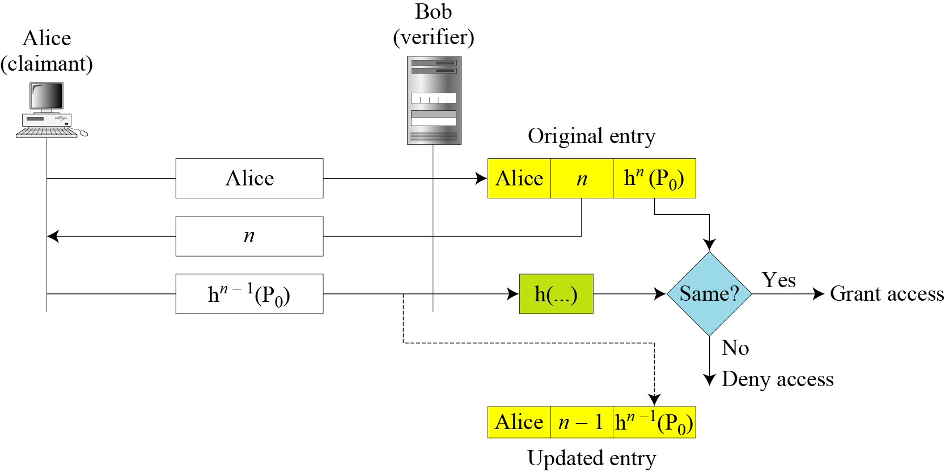
One Time Passwords
Third Approach

Slide 19
Biometrics
Biometrics is the measurement of physiological or behavioral features that identify a person
Authentication by something inherent
Biometrics measures features that cannot be guessed, stolen, or shared.
Components: Several components are needed for biometrics, including capturing devices, processors, and storage devices..
Enrollment: Before using any biometric techniques for authentication, the corresponding feature of each person in the community should be available in the database. This is referred to as enrollment.

Slide 20
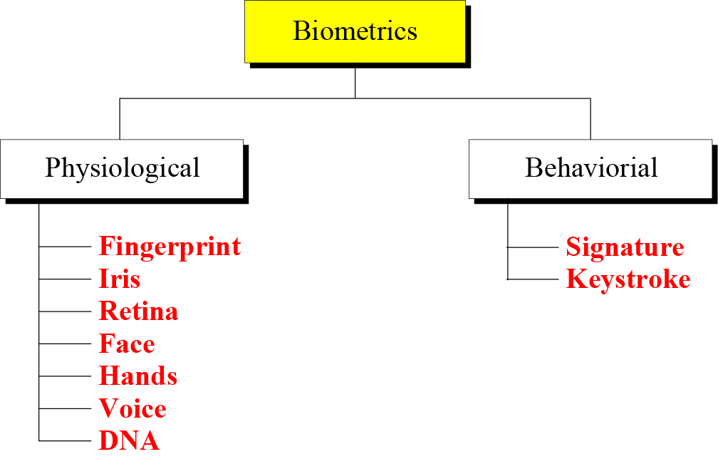
Biometrics
Authentication: is done by verification or identification;
in verification a person’s feature is matched against a single record in the database(one to one) to find if she is who she is claiming to be.
In Identification, a person’s feature is matched against all records in the database (one to many) to find if she has a record in the database. e.g. when a company needs to allow access to the building only to employees.
Techniques: Biometrics techniques can be divided into two broad categories:
Physiological
Behavioral

Slide 21
Biometrics Techniques
Physiological: these techniques measure the physical traits of the human body for verification and identification. To be effective the trait should be unique
Fingerprint: Have been used for a long time and show a high level of accuracy and support verification and identification. However, fingerprints can be altered by aging, injury, or disease.
Iris: The pattern within the iris that is unique for each person. Normally requires a laser beam. Very accurate and stable over a person’s life. Some eye diseases can alter the iris pattern.
Retina: The blood vessels in the back of the eyes. Devices are very expensive.
Face: Analyzes the geometry of the face based on the distance between facial features such as the nose, mouth and eyes. Some techniques combine geometric features with skin texture. Accuracy can be affected by sunglasses, growing facial hair and aging.
Hands: measures the dimensions of hands, including the shape and length of the fingers. Better suited for verification rather than identification

Slide 22
Biometrics Techniques
Physiological:
Voice: measures pitch, cadence and tone in the voice. Mostly used for verification. Accuracy can be diminished by background noise, illness or age.
DNA: the chemical found in the nucleus of all cells of humans and most other organisms. The pattern is persistent throughout life and even after death. Extremely accurate. Problem is that identical twins may share the same DNA.
Behavioral:
Signature: Conventional signatures. Signature tablets and special pens are used to identify the person (by signature). Also can measure some other behavioral traits like the time needed to writhe signature. Mostly used for verification.
Keystroke: The typing rhythm technique measures the behavior of a person related to working with a keyboard. Can measure the duration of key depression, the time between keystrokes, number and frequency of erros, the pressure on the keys, and so on. Not very accurate as trait can change with time. Also text dependent.

Slide 23
Biometrics Accuracy
Accuracy of biometric techniques is measured using two parameters; false rejection rate and false acceptance rate.
False Rejection Rate (FRR):
How often a person, who should be recognized, is not recognized by the system.
Measure as the ratio of false rejection to the total number of attempts. (percentage)
False Acceptance Rate (FAR):
Measures how often a person, who should not be recognized is recognized by the system.
Measures as the ratio of false acceptance to the total number of attempts (percentage)

Slide 24
Biometrics Applications
Several applications of biometrics are already in use.
In commercial environments, these include access to facilities, access to information systems, transaction at point-ofsales, and employee timekeeping.
In the law enforcement system, they include investigations (using fingerprints or DNA) and forensic analysis.
Border control and immigration control also use some biometric techniques.

